Slide 1
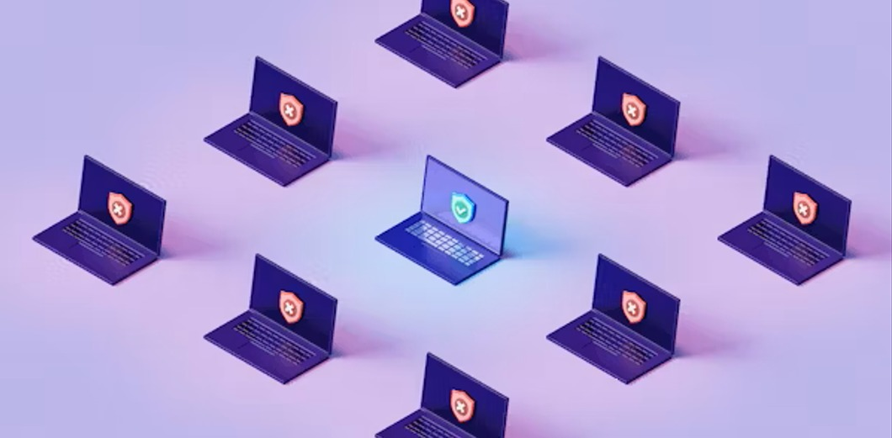
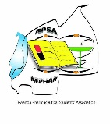

14TH RPSA INTERNATIONAL PHARMACEUTICAL SYMPOSIUM
Cybersecurity as a Primary Technological Concern in Telepharmacy
9th -11th May 2025
Kigali, Rwanda

Slide 2

14TH RPSA INTERNATIONAL PHARMACEUTICAL SYMPOSIUM
Presenter: Mr. Anastase DUKUNDABERA
aka Boticario
Teach enthusiast
Computer geek
BPharm Student at University of Rwanda
Tech Support Provider
Boti Tech Agency
📞 0791876041
📧 dukundanastase@gmail.com
9th -11th May 2025
Kigali, Rwanda

Slide 3
14TH RPSA INTERNATIONAL PHARMACEUTICAL SYMPOSIUM
Presentation Roadmap (Outline)
1. Introduction to Cybersecurity and Telepharmacy
2. Key cyber threats in healthcare and Pharmacy
3. Real-life examples
4. Solutions and cybersecurity tools
5. Call to action for Pharmacy professionals
6. Conclusion
9th -11th May 2025
Kigali, Rwanda

Slide 4

14TH RPSA INTERNATIONAL PHARMACEUTICAL SYMPOSIUM
🧠 Understanding Cybersecurity
“Cyber” = Computers/IT, Security is defined as the state of being free from danger or threat.
Hence, cybersecurity is about protecting data, devices, and networks
As it was written in forbes cybersecurity is not only a tech problem but also a patient safety issue.
Kigali, Rwanda

Slide 5


14TH RPSA INTERNATIONAL PHARMACEUTICAL SYMPOSIUM
What is Telepharmacy?
Remote delivery of pharmacy services using technology
Expands access to care, especially rural areas
Includes dispensing, counseling, monitoring
9th -11th May 2025
Kigali, Rwanda

Slide 6

14TH RPSA INTERNATIONAL PHARMACEUTICAL SYMPOSIUM
Why Cybersecurity Matters in Telepharmacy
Personal health data is highly valuable
Pharmacy systems store EHRs, prescriptions, patient profiles
Vulnerabilities = hacks, data breaches, and medication errors
“Healthcare data is 3x more likely to be targeted than financial data”
9th -11th May 2025
Kigali, Rwanda

Slide 7
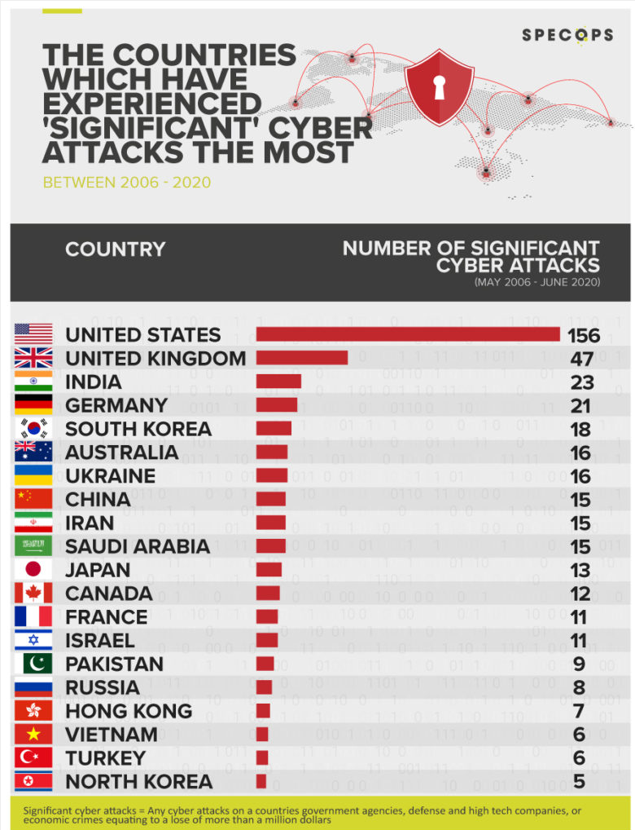
14TH RPSA INTERNATIONAL PHARMACEUTICAL SYMPOSIUM
Real-World Cyberattack Cases
According to HIPAA Journal of Los Angeles Times of Feb. 23, 2024, UnitedHealth pharmacy system hack
HIPAA reported that by 2021 USA alone has 355,000+ patients impacted by hacking
RNP had reported attempted cyber theft of Rwf 2 billion in 2027 only
9th -11th May 2025
Kigali, Rwanda

Slide 8
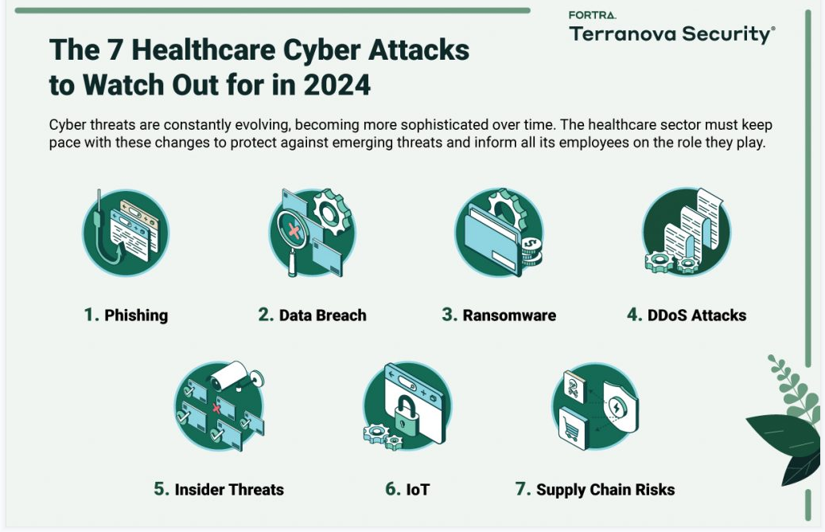
14TH RPSA INTERNATIONAL PHARMACEUTICAL SYMPOSIUM
Risks to Pharmacy systems
Data theft usually leads fraud and misuse
System disruption results in delay in medication delivery
Device hacking (e.g., insulin pumps) can cause patient harm and eventual death
9th -11th May 2025
Kigali, Rwanda

Slide 9
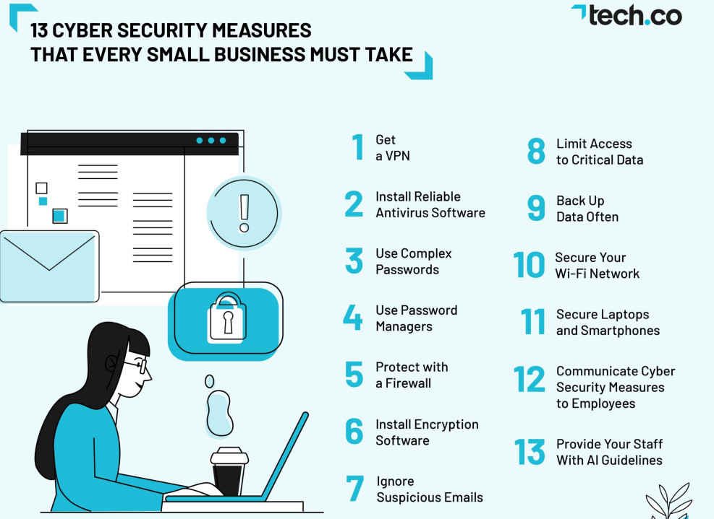
14TH RPSA INTERNATIONAL PHARMACEUTICAL SYMPOSIUM
Cybersecurity Measures in Telepharmacy
Encryption of EHRs
Firewalls and Antivirus
Multi-Factor Authentication
Training staff against phishing and malware
Cybersecurity Measures in Telepharmacy
9th -11th May 2025
Kigali, Rwanda

Slide 10
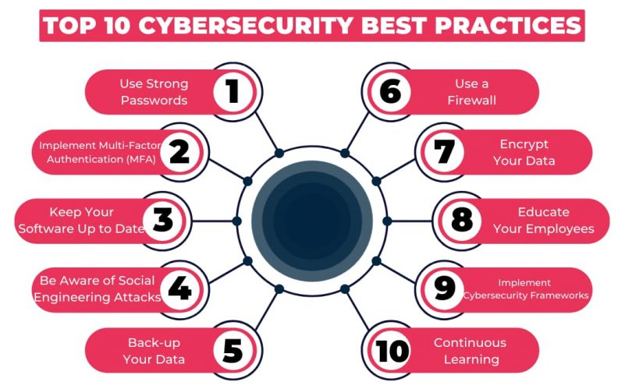
14TH RPSA INTERNATIONAL PHARMACEUTICAL SYMPOSIUM
Cybersecurity Best Practices
9th -11th May 2025
Kigali, Rwanda

Slide 11

14TH RPSA INTERNATIONAL PHARMACEUTICAL SYMPOSIUM
Role of Pharmacists in Cybersecurity
Stay informed
Advocate for safe digital tools
Report suspicious activity
Protect patient trust
9th -11th May 2025
Kigali, Rwanda

Slide 12
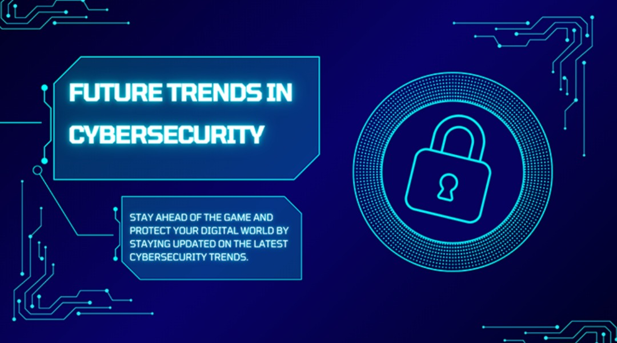

14TH RPSA INTERNATIONAL PHARMACEUTICAL SYMPOSIUM
Future Trends in Cybersecurity and Telepharmacy
AI-driven threat detection
Blockchain in EHRs
Cloud-based pharmacy platforms
9th -11th May 2025
Kigali, Rwanda

Slide 13
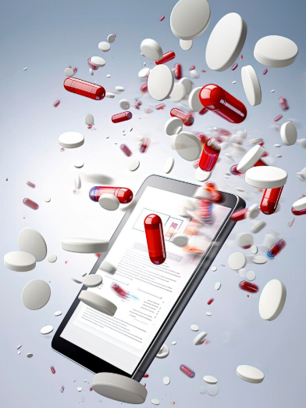
14TH RPSA INTERNATIONAL PHARMACEUTICAL SYMPOSIUM
Key Takeaways
Telepharmacy is transformative, but vulnerable
Cybersecurity protects both patients and systems
Pharmacists must play a role in digital health safety
9th -11th May 2025
Kigali, Rwanda

Slide 14
14TH RPSA INTERNATIONAL PHARMACEUTICAL SYMPOSIUM
Acknowledgement
Thanks to Mr. Pacifique AHISHAKIYE
PHO Sub. Rep for technical support
and
Mr Eugene RUSANGANIRA
https://github.com/Ana123tase/abstract-pharmaceutical-symposium/blob/main/CiberPharmacy_-_Anastase_DUKUNDABERA.pdf
9th -11th May 2025
Kigali, Rwanda

Slide 15

14TH RPSA INTERNATIONAL PHARMACEUTICAL SYMPOSIUM
Thank you!!
for Your Kind Attention
9th -11th May 2025
Kigali, Rwanda

